Slide 1



MP Local Election
Polling Party Randomization Software 2020-21
Online
DATA ENTRY APPLICATION- Local Election-2020-21
LIVE Demo 9TH December 2020

Slide 2
MP Local Election
Polling Party Randomization Software 2020-21
EPDS STATUS- ECI V/S SEC
ECI –CEO MP HAS USED IN M P STATE GENERAL ASSEMBLY 2018 LOKSABHA 2019 MP BYE ELECTION 2020.
SEC-EPDS IS CUSTOMIZED FOR DATA ENTRY 1. MP LOCAL ELECTION URBAN 2020-21 2. MP LOCAL RURAL ELECTION 2020-21

Slide 3
MP Local Election-
Polling Party Randomization Software 2020-21
SEC-EPDS RANDOMIZATION NORMS
TYPE OF ELECTION | RANDOMIZATION BASE
NAGAR NIGAM MAYOR ELECTION | ASSEMBLY CON./Ward
NAGAR PARISHAD | BLOCK BASED
NAGAR PANCHAYAT | BLOCK BASED

Slide 4
MP Local Election
Polling Party Randomization Software 2020-21
SEC-EPDS MASTER TABLES
ACCURANCY REQUIRED - 100%
S.NO. | MASTER TABLE
1 | BLOCK TABLE
2 | ULB (NIKAY) /WARD TABLE
3 | POLLING BOOTH TABLE
4 | EMPLOYEES TABLE
5 | JANPAD/ GRAM PANCHAYAT

Slide 5
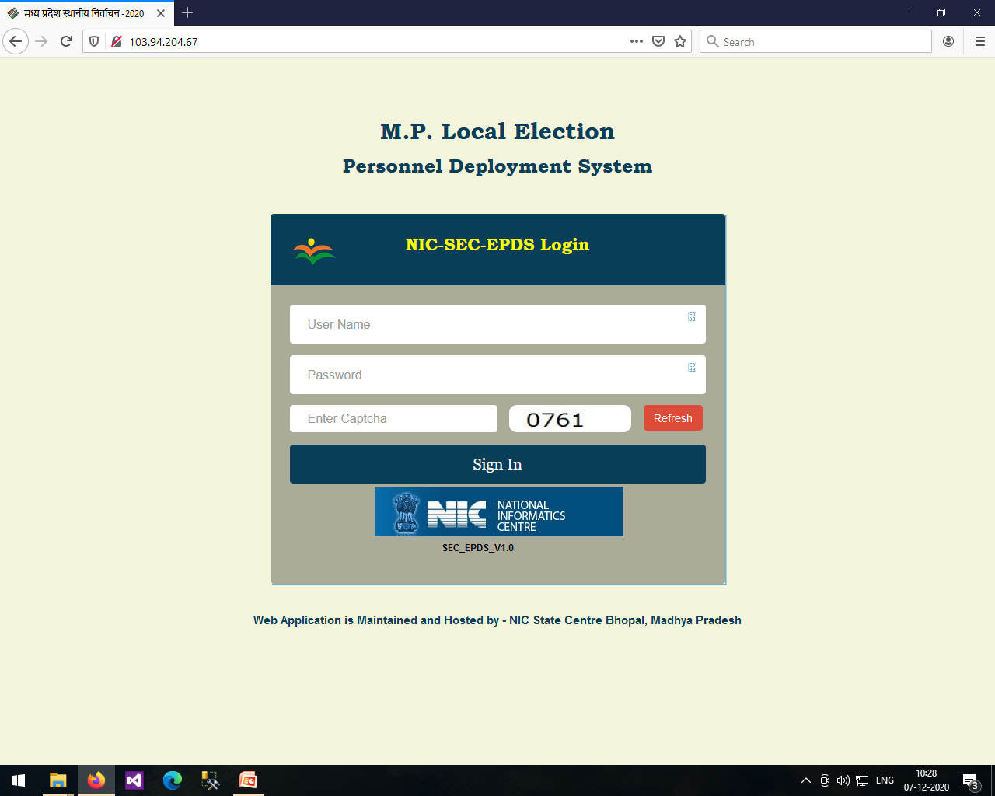
MP Local Election- Url
Polling party Randomization Software 2020-21 http://103.94.204.67

Slide 6
MP Local Election-
Polling Party Randomization Software 2020-21
SEC-EPDS LOGIN-TYPES
TYPE OF LOGIN | ROLE OF LOGIN USER
STATE ADMIN – NIC LOGIN | STATE MASTER TABLES CONTROL
1. DISTRICT ADMIN-OCPMP | FULL CONTROL ON DISTRICT DATABASE
2. DISTRICT HOD-DEP | FULL CONTROL OVER HIS OFFICE DATA
3. OPERATOR-HOD-DATA ENTRY | DATA ENTRY RIGHTS ONLY

Slide 7
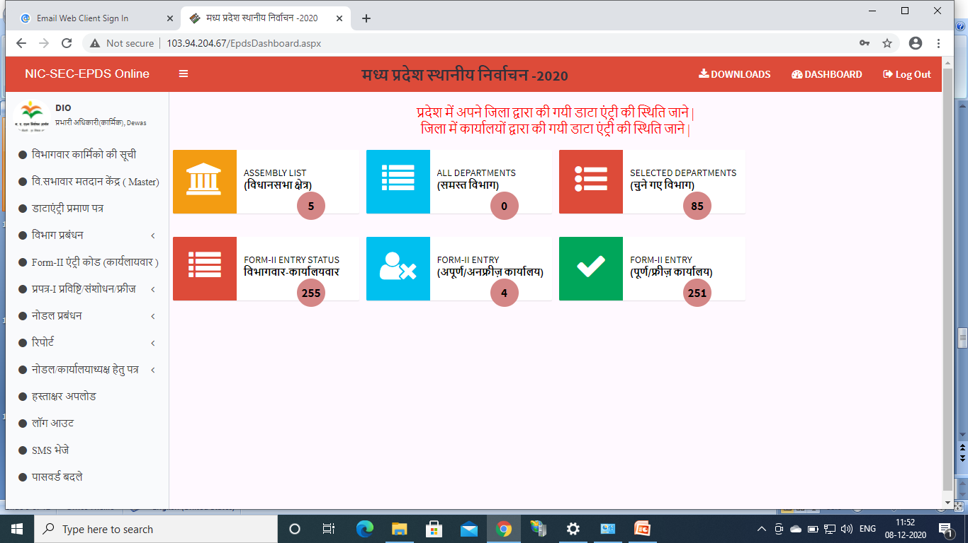
MP Local Election-
Polling Party Randomization Software 2020-21
DISTRICT ADMIN-ocp login

Slide 8
MP Local Election-
Polling Party Randomization Software 2020-21
DISTRICT ADMIN-login
DISTRICT ADMIN LOGIN MENU OPTIONS
DISTRICT DASHBOARD
DEPART. MANAGEMENT/REPORT
POLLING BOOTH ENTRY
FORM-1/2 CONTROL
NODAL MANAGEMENT/LETTER ISSUE
DATA FREEZ/ SIGNATURE UPLOAD

Slide 9
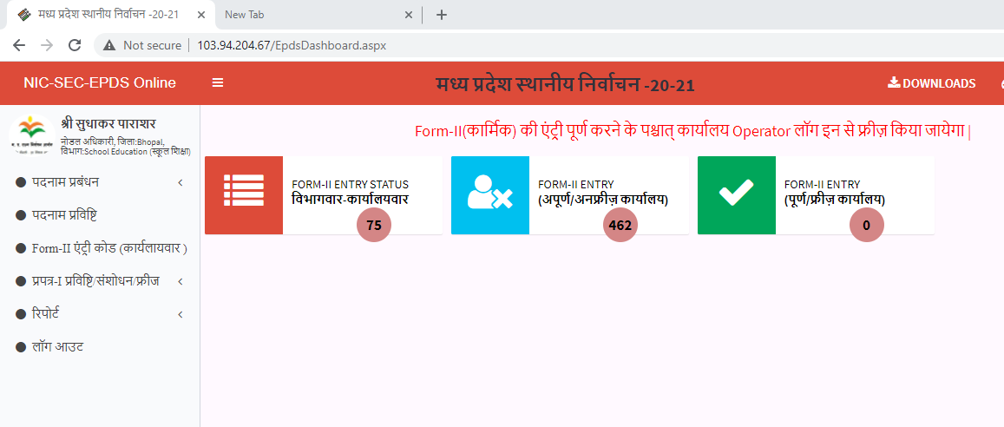
MP Local Election-
Polling Party Randomization Software 2020-21
DISTRICT HOD

Slide 10
MP Local Election-
Polling Party Randomization Software 2020-21
DISTRICT HOD
DISTRICT HOD LOGIN MENU OPTIONS
DESIGNATIONS (ADD/EDIT)
FORM-1 (ENTRY/FREEZ)
FORM-1 (CHECKLIST OFFICE/DEPT WISE)
FORM-2 (SECURITY PIN BY SMS)
REPORTS OF EMPLOYEES
OFFICE FREEZ/UNFREEZ

Slide 11
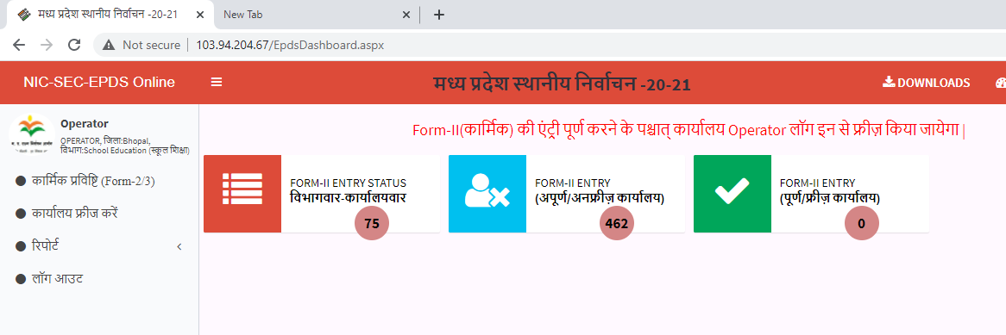
MP Local Election-
Polling Party Randomization Software 2020-21
DISTt-OPERATOR

Slide 12
MP Local Election-
Polling Party Randomization Software 2020-21
EDISTRICT HOD-OPERATOR
DISTRICT HOD- OPERATOR RIGHTS
DATA ENTRY
DATA FREEZ AFTER ENTRIES OVER
REPORT GENERATION

Slide 13
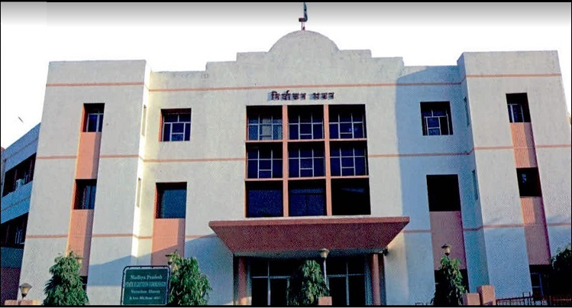
MP Local Election
Polling party Randomization Software 2020-21
Continue-Online Appkication
Team-NIC
A K Bhatnagar
B Bhaskar Rao

